Slide 1
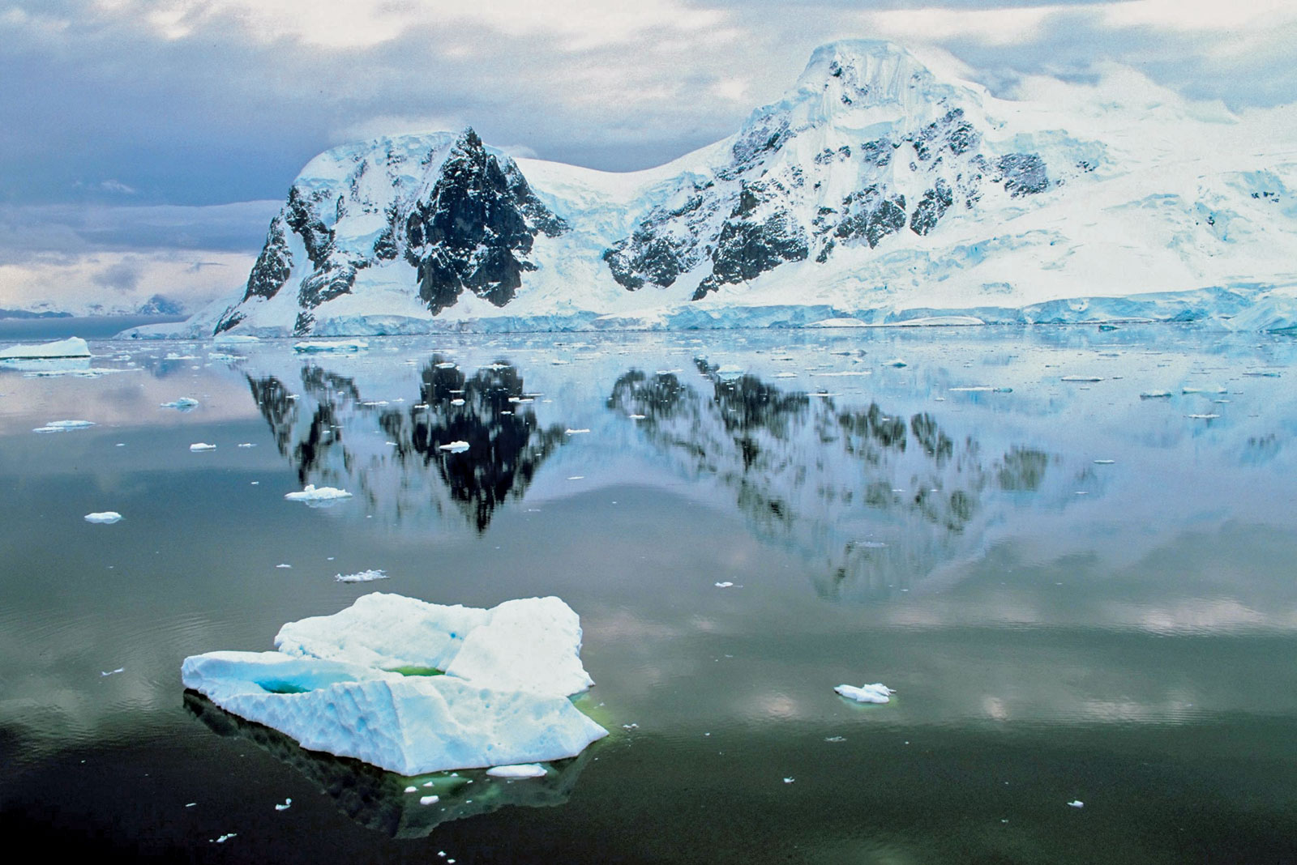
Numeracy:
Number:
Addition and subtraction, partitioning numbers to support addition and subtraction, mental strategies and written methods, known number facts used to support.
Measures
Time- tell and write time, o’clock, half past, quarter to and quarter past and five minute interval for extended learning, links to position and direction (half, quarter, three quarters clockwise, anti-clockwise)
Length using standard measures: mm/cm/m and recognition of which measure is appropriate for different distances and objects.
Mass: Using standard weights to support measures- g, kg and use of weighing scales and reading off scales (use alongside balance scales to weigh with greater accuracy)
Volume: Using standard measures: l/ml and recognition of which measure is appropriate and using appropriate apparatus to read l/ml.
Phonics
1.20-1.40 Mon/Wed
Children streamed for phonics sessions
Literacy
Traditional Tales
Narrative: detailed character description profiles; settings, wanted poster, alternative endings/stories, fairy tale investigation.
Reports: Report on Shackleton South Pole Expedition, inc. dictionary work and glossaries.
Instructions and ‘Top Tips’ for an Antarctic explorer- cause and effect conjunctions.
SPAG
taken from NC English Appendix and covered as planned by individual class teachers to meet needs of class. Year Two Common Exception Words and Year Two spelling patterns taken from NC 2014 (pages 45 to 48)
Grammar: requirements set out on page 65/66 of NC English Appendix.
PSHE/SEAL
Going for Goals
Saying ‘no’ is ok.
Online Safety.
Antarctica:
Famous People
Spring 1
History:
Understand the lives of significant men, women and children drawn from the history of Britain and te wider world- Shackleton and other explorers.
Geography: Antarctica
Identify physical/human features (Antarctica, Polar regions).
Link own locale with contrasting locality studied, exploring distance.
Continents and oceans in the World.
Use of secondary sources- researching to source information.
Penguin studies- types of penguins that live in Antarctica- look at how these animals survive (cross curricular links with Science).
Music:
Exploring pulse , rhythm:
Replicate pulse and rhythm
Call and respond activities
ICT- Programming
Retrieval and storage of information:
Using secondary sources to research information on ‘explorers’ relating to Antarctica topic.
Use appropriate apps and software packages to store and save information in order to edit and manipulate text, adding images, etc. as appropriate.
PE
Gymnastics: Balance, co-ordination and agility on the floor and using apparatus.
Includes extra PE sessions with sports coach, Mr Thorpe- defending and attacking, throwing and catching skills accessed via team games.
Art:
Try out tools and techniques and apply these materials and processes
Represent observations, ideas and feelings, and design and making images and artefacts.
Visual and tactile element, including colour pattern and texture, line and tone, shape, form and space.
Working on their own clay to produce model of penguins: design, make, evaluate, technical knowledge.
Science: Animals including humans: -identifying different animals and naming them -What do animals and humans need to survive? -Importance of diet and exercise on human body.
Investigate: Have the tallest people in our class got the biggest feet?
How clean are your hands? (bread experiment)
Heart rate and exercise.
RE:
Rules and Routines
Ten Commandments (Christianity and Judaism), Shabbat (Judaism), The Five Pillars (Judaism)
The Five K’s (Sikhism)
Making decisions (humanism)

