Slide 1
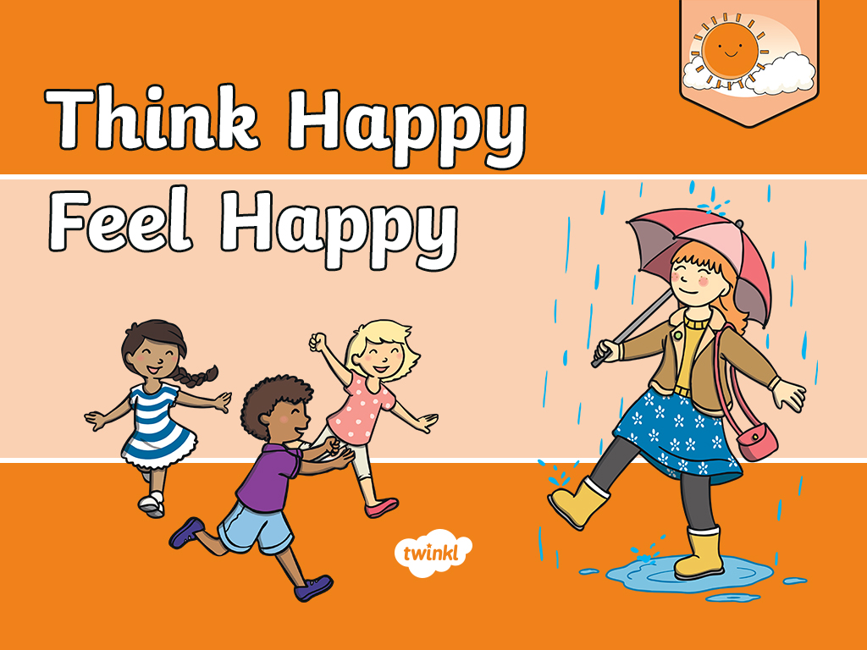

Slide 2
Aim
I understand how happy thoughts can make me feel better.
Success Criteria
I can describe different emotions and consider how to deal with different feelings.
I can identify positive and negative thoughts.
I can think of different, more positive ways, to think about things.
This resource is fully in line with the Learning Outcomes and Core Themes outlined in the PSHE Association.

Slide 3
The Big Questions

Slide 4

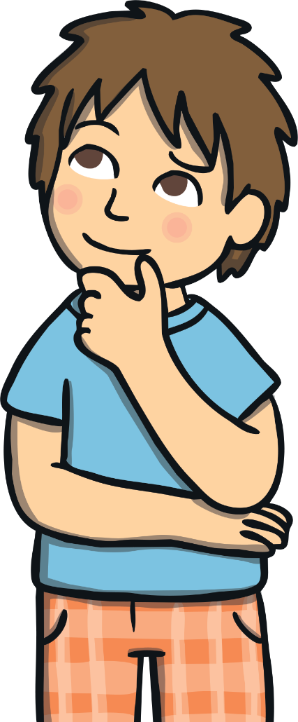
What is positive thinking?
How can it help us feel good?

Slide 5
Reconnecting

Slide 6
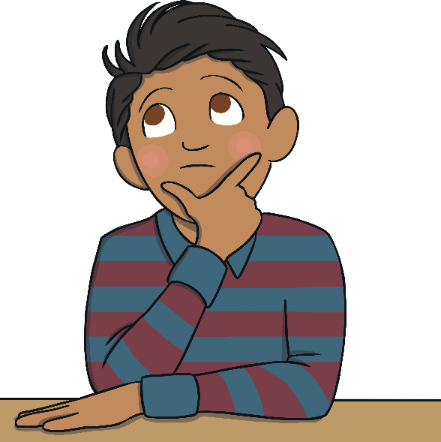
Think a Happy Thought
Let’s sit very quietly.
Try to clear your mind.
If it helps, you can close your eyes.
Now, think of a happy thought…
This could be something you are looking forward to or a happy occasion that you were part of.
It might be a thought about a particular person or place that makes you feel happy.

Slide 7
Exploring

Slide 8

What Is Positive Thinking?
What is positive thinking?
Well, being positive means looking for the good in things, rather than the bad.
A positive thinker focuses on making the best of a situation, rather than complaining about it.
Positive thinkers are said to ‘look on the bright side’.

Slide 9
What Is Positive Thinking?
Can you think of positive words?
These are words we might use if we are thinking positive, happy thoughts, rather than complaining and being grumpy.
Think of a positive word you might use if you were sharing a happy memory or talking about a person or place that makes you happy.
Did you get any of these?
enjoy
smile
good
fantastic
brilliant
amazing
special
love
great
nice
better
laugh
best

Slide 10

Positive Thoughts
Have you ever looked outside when it’s been raining and felt a bit down because it means you can’t go out to play? That’s the down side of rain, but there is an up side, too.
A positive person might say to themselves,
‘What great weather for all the plants that need a drink!’

Slide 11
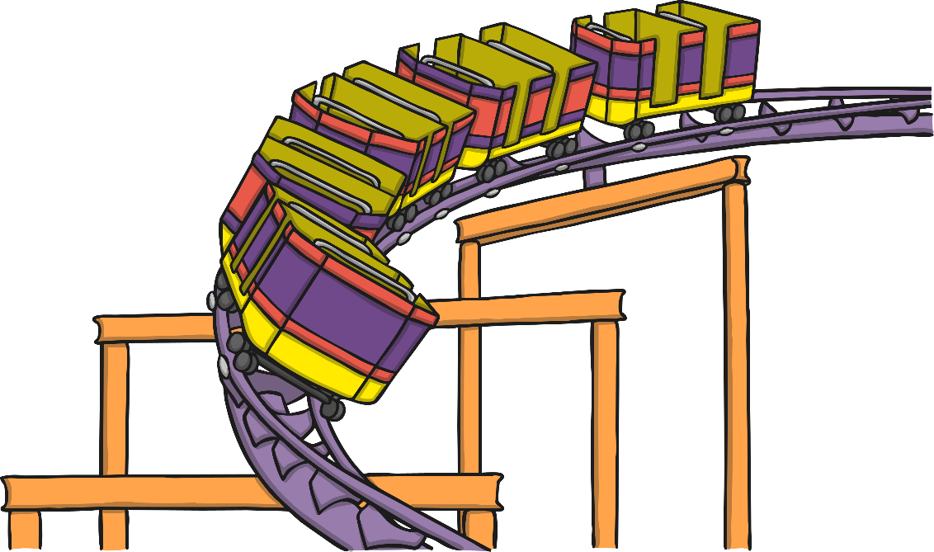
Positive Thoughts
Imagine you are having an exciting day out, perhaps at the park or the beach or the funfair. You have had a great morning and it is
now lunchtime.
Some people might feel a bit sad that the morning has gone and that they now only have half a day left until home time. They are focusing on the negative, not the positive.
A positive thinker would say,
‘What a great morning – and we still have the whole afternoon left to enjoy!’

Slide 12
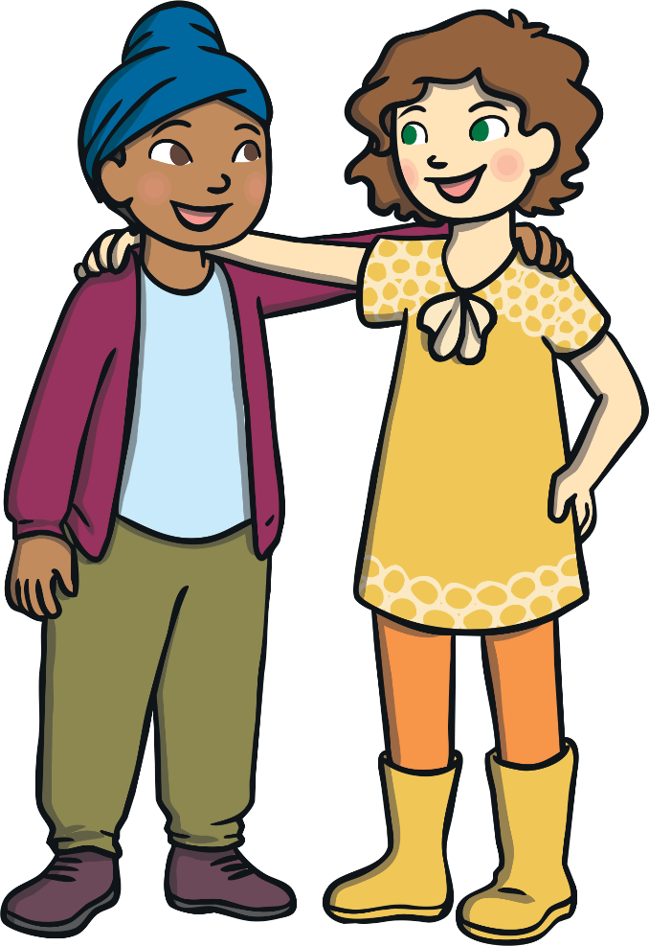
Positive Thoughts
How many of you have had a friend over to play, then made a bit of a grumpy fuss when it is time for them to go home?
Well, a positive thinker might say to themselves,
‘I had a great time with my friend. I hope they can come round again or I might get invited to their house.’

Slide 13
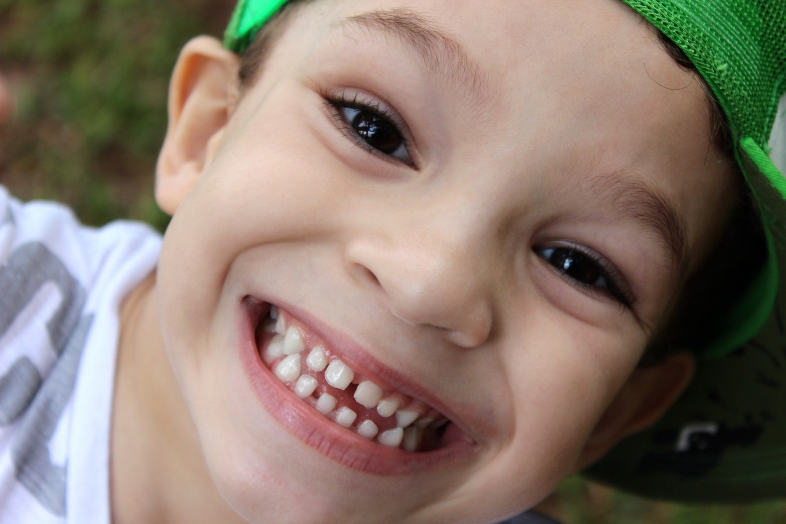
Think Happy, Feel Happy
Consolidating
Reflecting

Slide 14
Consolidating

Slide 15

Every Cloud Has a Silver Lining
There is a saying, ‘Every cloud has a silver lining’.
People think of clouds as grey and grumpy. They block the sunshine and are often full of rain to spoil the day.
But lots of people say that even in a grey and grumpy cloud, there is something good; that’s the silver lining.
So, when something not-so-good happens, you can usually find something that is good about that situation if you look hard enough.

Slide 16
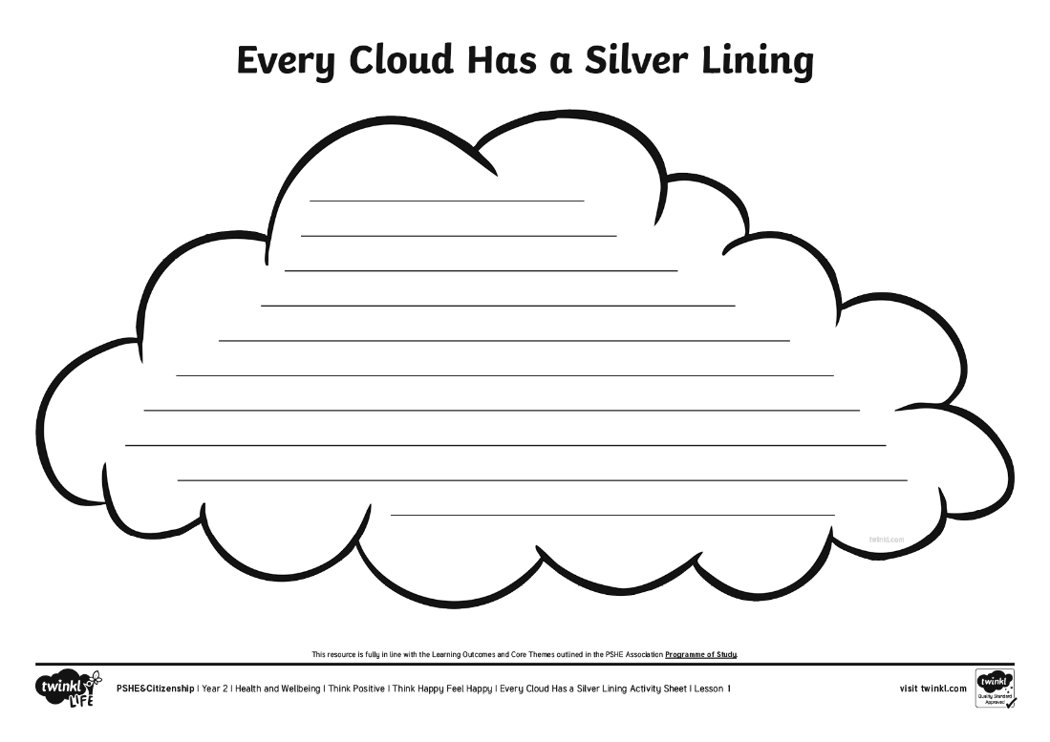
Every Cloud Has a Silver Lining
Print out the Every Cloud Has A Silver Lining Activity Sheet for
this activity.
Listen to the following story and how the child in the story feels. See if you can find a positive thought to write on your cloud, looking for the good in the situation, instead of focusing on the bad.

Slide 17

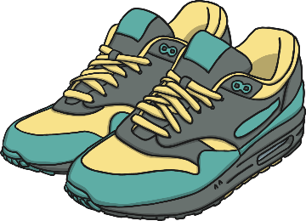
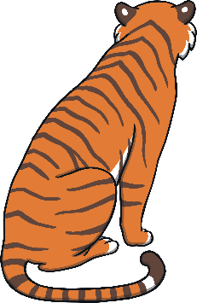


Every Cloud Has a Silver Lining
Jude is off to the zoo with Dad. It is summer
but the sun is behind the clouds.
Dad won't let Jude wear the new trainers they bought at the weekend.
Jude really wants to see the big cats, particularly the tigers, leopards and lions, but last time they were all asleep in the shade at the back of their enclosures so no one could see them.
Dad has forgotten the picnic and the camera!

Slide 18
Every Cloud Has a Silver Lining
So Jude seems to be focusing on the negative things about the day – things that have gone wrong or things that might spoil the day.
Can you think of some positive thoughts Jude could have about
the situation?
What is good about the sun being behind the clouds?
What is good about not being allowed to wear the new trainers?
What might happen today with the big cats?
What could Jude and Dad do instead of having a picnic?
What could Jude and Dad do instead of taking photos?

Slide 19


Every Cloud Has a Silver Lining
What sort of a day will Jude and Dad have if they focus on the negative thoughts and things that have gone wrong?
What sort of day will Jude and Dad have if they look for the positives and try to look on the bright side?

Slide 20


Every Cloud Has a Silver Lining
Sometimes, we experience difficult or challenging times. Can you think of a time where things have been tough? Maybe things have changed or you have felt uncertain about what’s going on.
Print off another Every Cloud Has A Silver Lining Activity Sheet and draw or write down all the positives about that difficult situation. If you look hard enough, there can be a silver lining to almost
all situations.

Slide 21
Reflecting

Slide 22

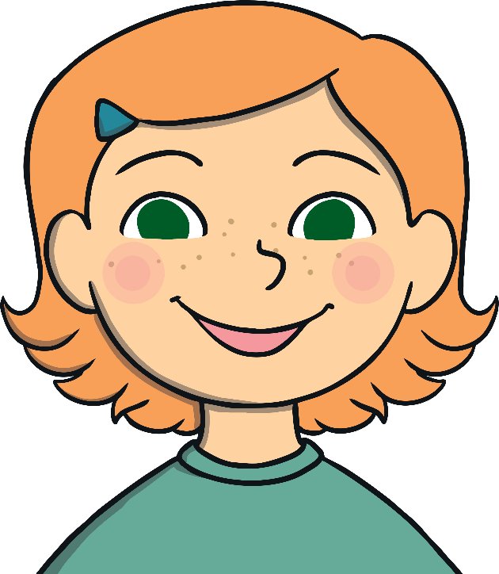
Turn That Frown Upside Down!
Help this negative person to look on the bright side.
Help them to think positively about their situations.
Listen to what they say, then think of something positive they could say instead.
If they think happier thoughts, they’ll feel better and their frown will become a smile.

Slide 23
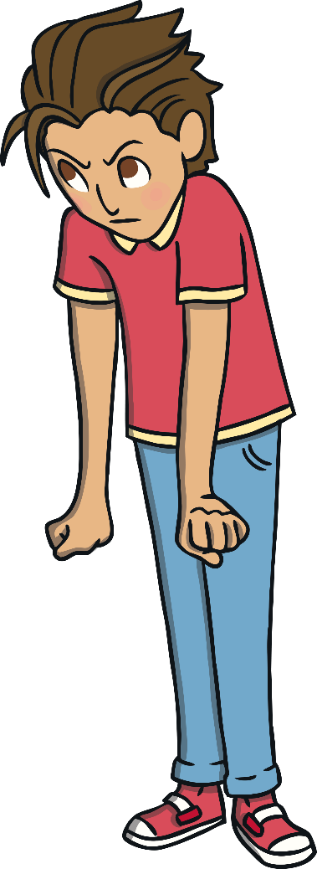
Turn That Frown Upside Down!
I don’t like it when it’s dark at night.
I hate the night I have to eat broccoli for tea!
Oh no! My best friend is off school today because they are ill.
This lesson is so hard. I’ve never done these sorts of calculations before.
My favourite T-shirt is too small and I can’t wear
it anymore.

Slide 24
The Big Questions

Slide 25
What is positive thinking?
How can it help us feel good?

Slide 26
Aim
I understand how happy thoughts can make me feel better.
Success Criteria
I can describe different emotions and consider how to deal with different feelings.
I can identify positive and negative thoughts.
I can think of different, more positive ways, to think about things.

Slide 27


