Slide 1
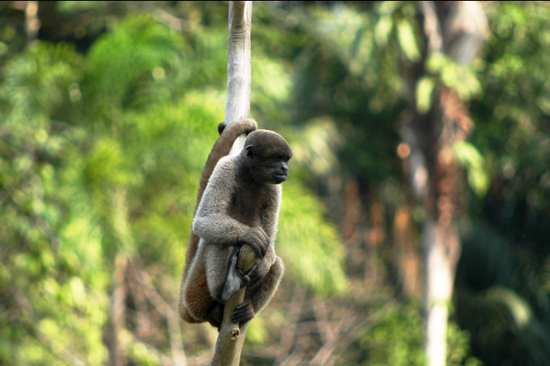

Animals of the Rainforest Quiz
Notes:
Animals of the Rainforest Quiz
This quick animal quiz will help learners to identify and name a variety of rainforest animals. Can your pupils spot the animal which doesn’t live in the rainforest? The activity includes 10 high-resolution animal photos, facts about each animal and additional questions.
WWF provide more in depth information on some of the incredible animals that live in the rainforest: http://wwf.panda.org/what_we_do/where_we_work/amazon/about_the_amazon/wildlife_amazon/
Curriculum links – Science: Identify and name a variety of common animals including fish, amphibians, reptiles, birds and mammals
Photo Credits: Jenny Matthews/ActionAid, Lizzy Foulkes/ActionAid, Raplefou, Mary Gallo, Richard Lunsford, Adrian Hoskins.

Slide 2
Welcome to the Animals of the Rainforest Quiz!
Animals of all shapes and sizes live in the rainforest. Can you help answer some questions about these animals and reveal the secret facts? One of these animals doesn’t live in the Amazon rainforest. Can you work out which one?
I’m a…

Slide 3
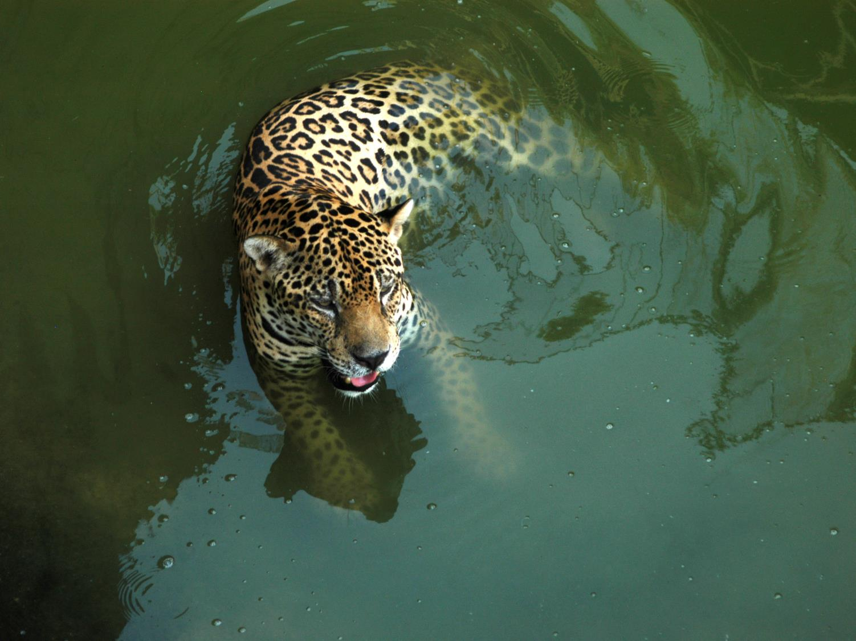
The name of this animal is a…?
panther
jaguar
cheetah

Slide 4
Jaguars are the largest of Brazil’s big cats and the third largest in the world after lions and tigers. Unlike many other cats, jaguars don’t avoid water and are actually quite good swimmers!
Why do you think jaguars like to be in water during the middle of the day?
I’m a…
jaguar

Slide 5
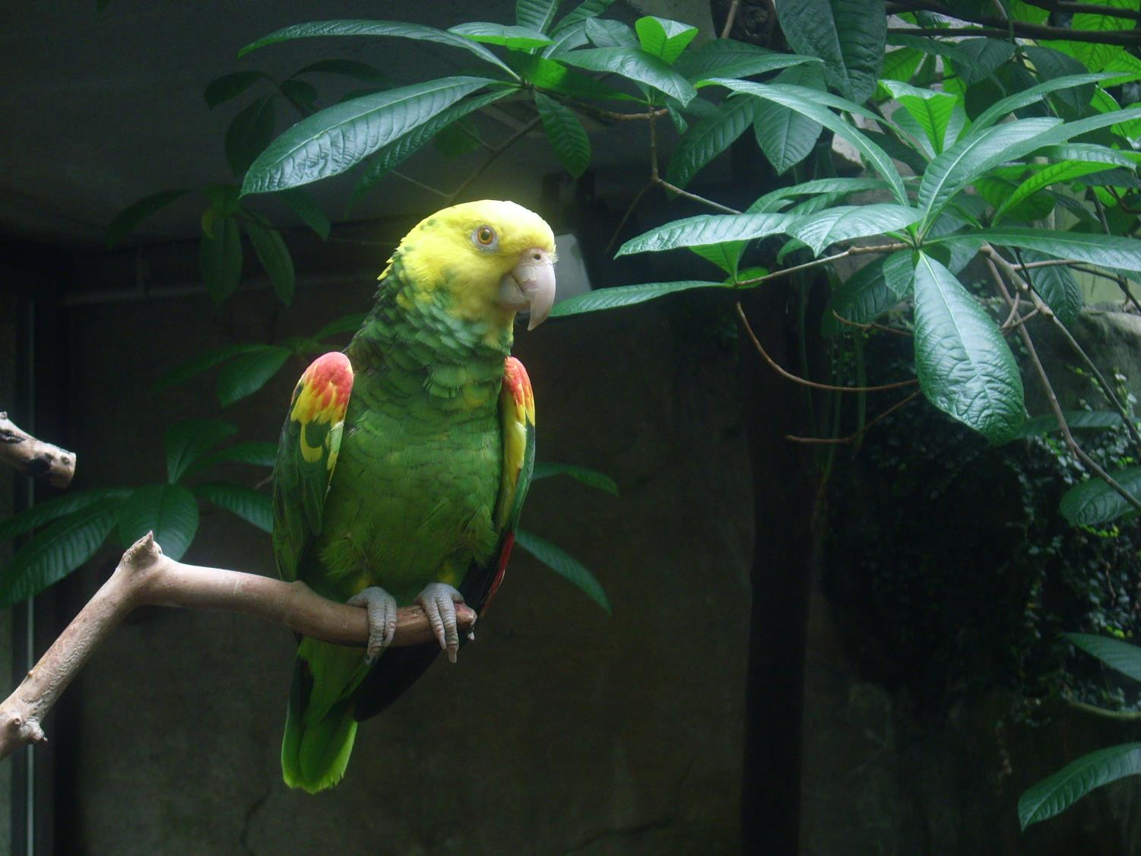
Is this parrot a…?
mammal
fish
bird

Slide 6
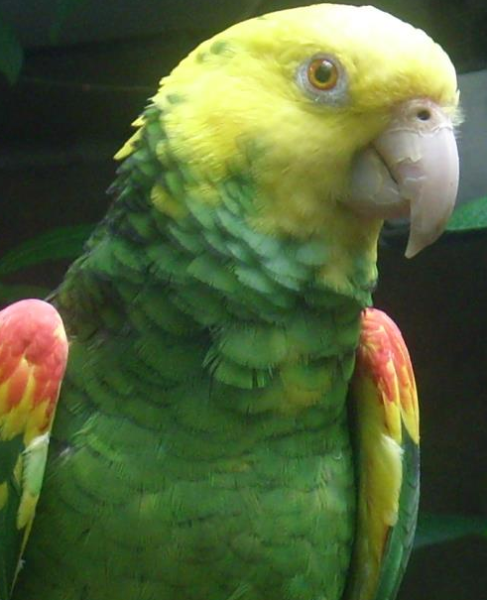
Parrots are birds. This type of parrot is called a Yellow-Headed Amazon parrot. It can live for up to 60 years.
Can you remember what colour the parrots feathers are?
Hi again! Did you remember?
This parrot is a…
bird

Slide 7
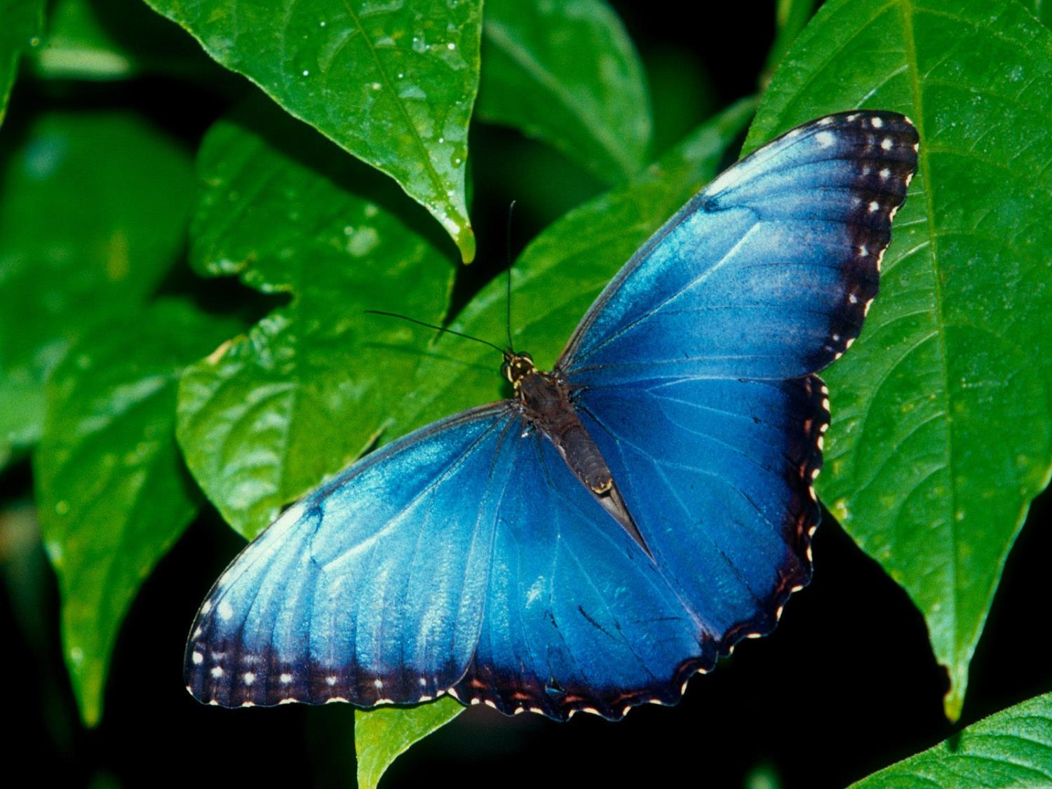
This insect is a…?
butterfly
dragonfly
moth

Slide 8
The rainforest has some of the world’s biggest insects. This is an Amazon Blue Morpho butterfly. Its wings can be as wide as 18 cm which is probably bigger than your hand!
Have you ever seen a butterfly? What colour was it?
This insect is a…?
butterfly

Slide 9
This monkey is a…?
reptile
bird
mammal

Slide 10
Monkeys are mammals. This monkey is a spider monkey. It wraps its tail around trees like an extra arm. There are so many species of monkey in the Amazon that scientists keep discovering new ones.
Which is longer, the monkey’s arm or its tail?
Hi again! It looks like my tail is longer but it’s hard for me to tell because it’s behind me!
This monkey is a…?
mammal

Slide 11
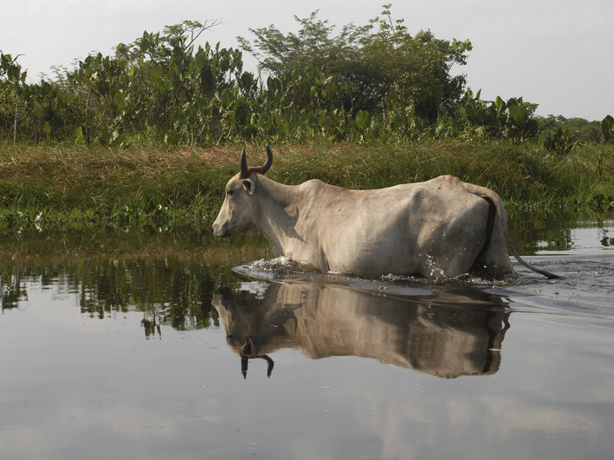
The name of this animal is a…?
cow
zebra
donkey

Slide 12
This one is a bit of a trick question…
These cows do live in the rainforest, but it’s not their natural home.
They were brought here to help farm the land by pulling ploughs, and provide milk and other dairy products.
The name of this animal is a…?
cow

Slide 13
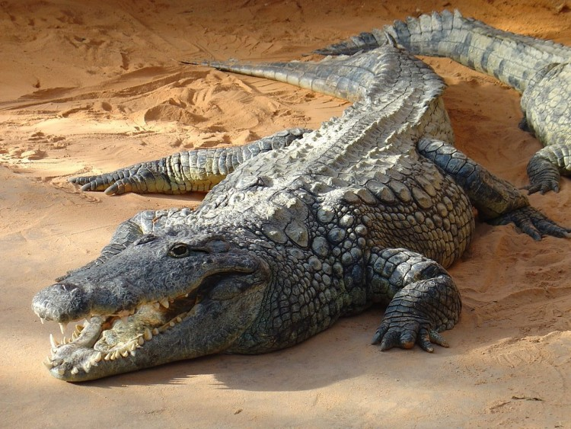
This animal eats…?
plants
meat
chocolate

Slide 14
This is a caiman, a type of crocodile. These animals are canivores, which means they eat meat. Caimans have scaly skin and are mostly nocturnal which means they are active at night. Some can grow to be around five metres long!
How is this caiman’s tail different from the spider monkey’s tail?
This animal eats…?
meat

Slide 15
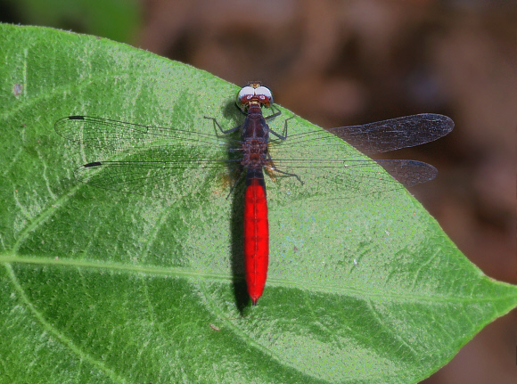
This dragonfly is an insect...?
true
false

Slide 16
Dragonflies are insects. This dragonfly is a Flame-tailed Pondhawk. Over 90% of animals in the rainforest are insects. Dragonflies can fly backwards, change direction in mid-air and hover for over a minute.
How many legs does an insect have?
This dragonfly is an insect...?
true

Slide 17
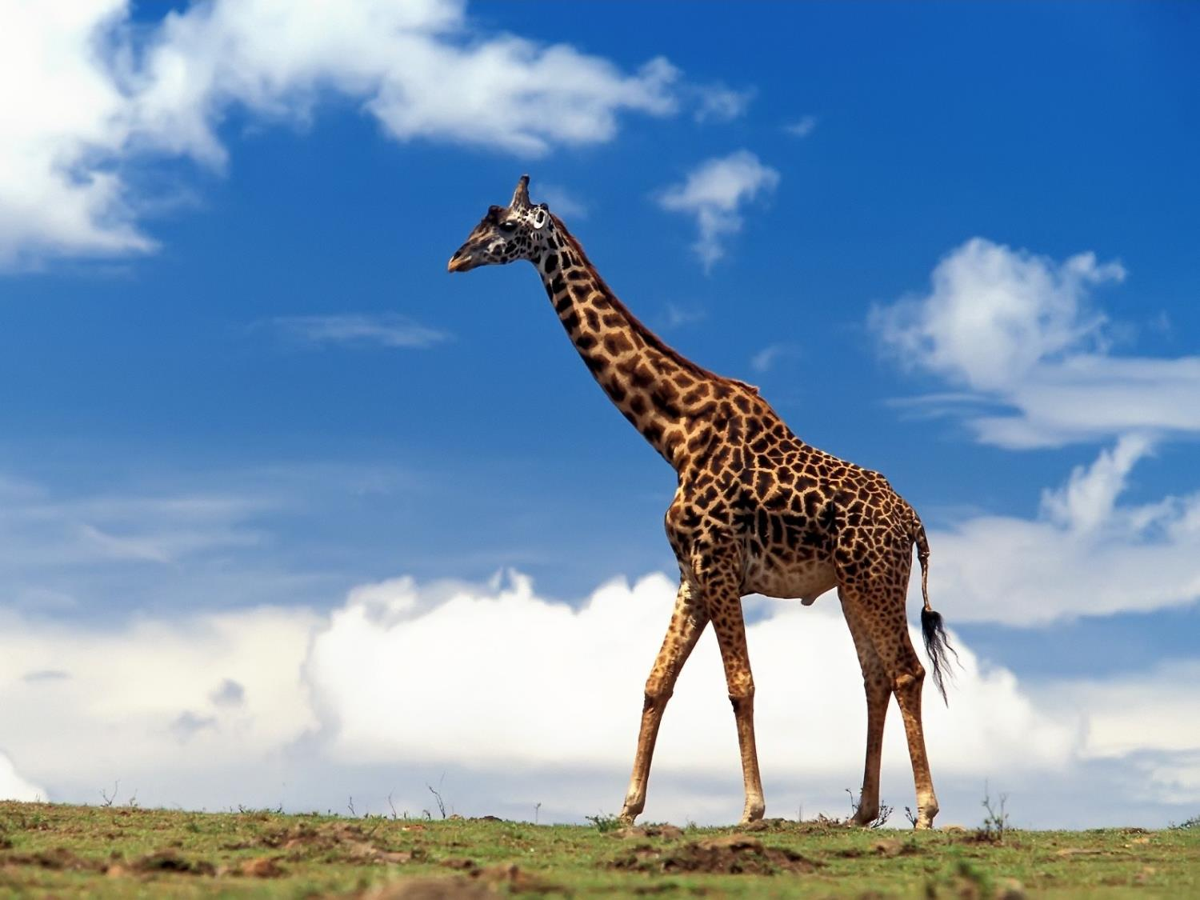
This animal eats…?
meat
crisps
leaves

Slide 18
^{Have you spotted it?}
Giraffes don’t live in the Amazon rainforest!
They are the tallest animal in the world and might like eating leaves from the tall trees. However, giraffes live across the continent of Africa.
This animal eats…?
leaves

Slide 19
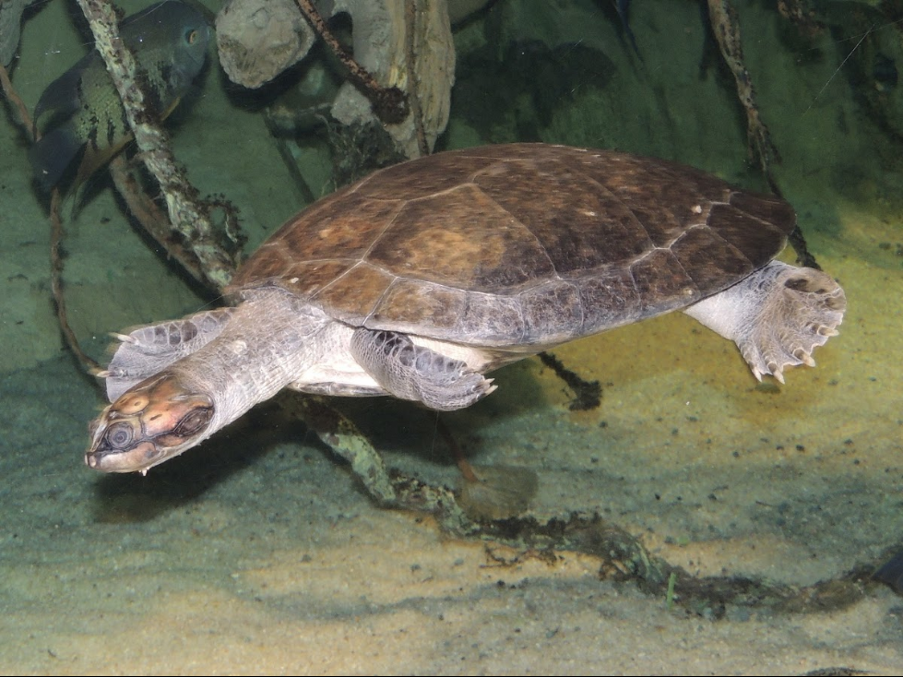
The turtle has a hard…?
skin
shell
hat

Slide 20
Turtles have hard shells to protect them from predators. The Giant Amazon River Turtle can have a shell longer than 70cm and can weigh as much as 100kg, more than most humans!
What do you notice about the turtle’s feet?
The turtle has a hard…?
shell

Slide 21
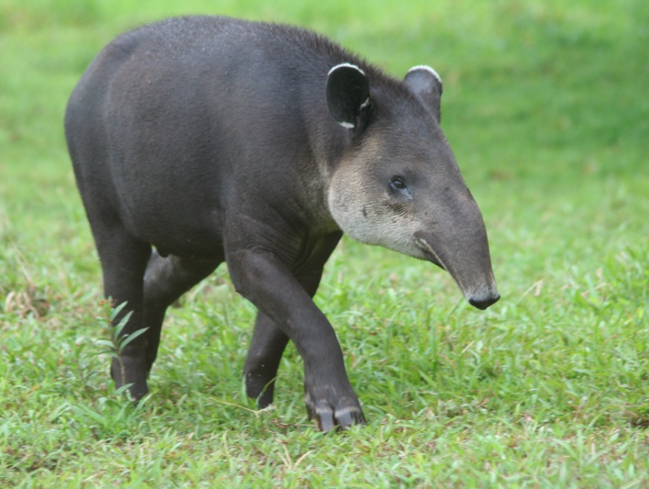
A tapir uses its long snout to…?
Smell animal scents
Clean itself
Pluck fruit from trees

Slide 22
Tapirs are herbivores, meaning they eat plants and fruit. They use their long snout to pluck fruit from trees. They are related to horses and rhinoceroses. Tapirs enjoy water and like to swim and wallow in mud.
Does this tapir remind you of any other animals?
A tapir uses it’s long snout to…?
Pluck fruit from trees

Slide 23
^{Well done!}
You’ve completed the Animals of the Rainforest Quiz.
Which was your favourite animal?

