Slide 1

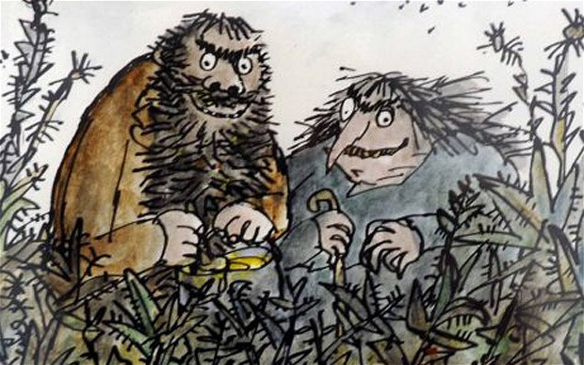
The Twits

Slide 2

Session 1
Predict what will happen in the story
Write a prediction of what you think will happen in the story. Only use the front cover to help you. Try and give reasons for your predictions, for example, ‘I predict that there will be two old people who enjoy gymnastics because on the front cover there is a man and a woman with some grey in their hair, doing handstands!
predict evidence why because characters settings events

Slide 3
Session 2
Can you describe Mr. Twit?
mean ugly
dirty cruel
horrible mucky
unkind bad
evil messy

Slide 4

Session 3
Hot-Seat the frog
The poor frog! Stuck in a bed with Mrs. Twit. How do you think he felt? First write a list of questions you’d like to ask the frog.
angry upset surprised anxious not amused
scared worried

Slide 5
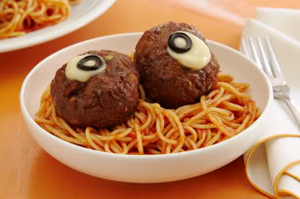
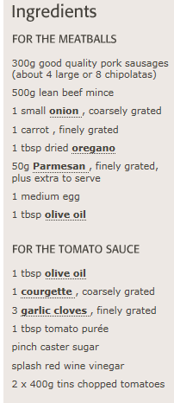
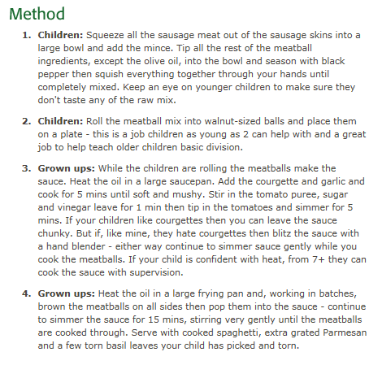
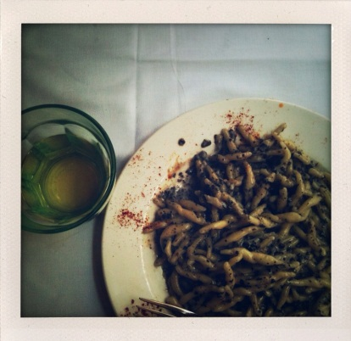
Session 4
Create a new receipe for Mr. Twit’s dinner
Eurgh! Mr. Twit did NOT like worm spaghetti. Can you write him a recipe for a tastier dish? Or if you don’t think he deserves it, perhaps you’ll choose to create him an even more revolting dish…
Make sure you write a list of ingredients and a method (instructions).

Slide 6
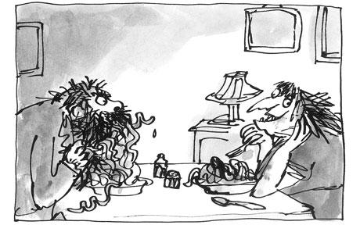
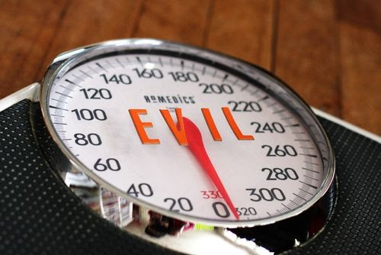
Session 5
Design your own nasty trick
Mr. and Mrs. Twit play some nasty tricks on each other. Are you more or less evil than then The Twits?
Find out by designing the worst trick you can think of…
nasty vicious evil premeditated callous
horrible mean

Slide 7
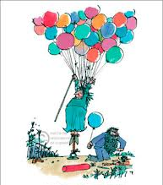
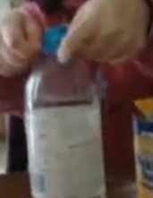
Session 6
Balloon Experiment
What do you think will happen if you put a deflated balloon with baking soda over a bottle of white vinegar?
Plan, predict, carry-out and write your findings!
experiment baking soda white vinegar plan predict findings record observe conclude

Slide 8
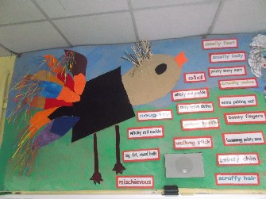

Session 7
Collage the Roly-Poly Bird
Collect lots of different types of materials; sweet wrappers, tin foil, feathers, shells, newspaper, magazines, bottle tops…
Use a range of materials to collage the Roly-Poly bird.
collage materials glue stick layer rip

Slide 9

Session 8
Research Muggle-Wump’s home country
What do you know about where Muggle-Wump comes from?
Can you write six facts about this continent?
geography population land use traditions culture distance size

Slide 10






Session 9
Which front cover is most eye-catching and why?
Design your own front cover that you think is even more eye-catching than the examples above. How will you make a cover that people will want to buy?

