Slide 1





Year Two’s Ultimate Quiz!
Enjoy this quiz with your family!
You could even make teams and see who are the winners, but remember it’s the taking part that counts!
Week One

Slide 2










Round 1… Logo Picture Round
1 | 2 | 3 | 4 | 5
6 | 7 | 8 | 9 | 10

Slide 3
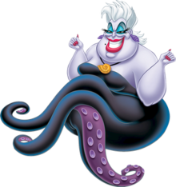
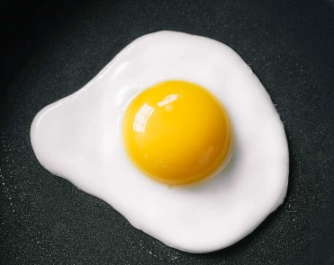
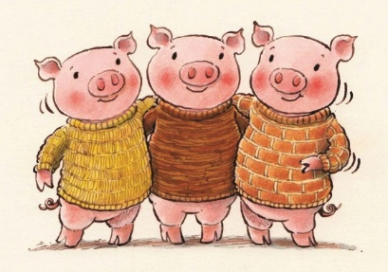
Round 2… General Knowledge Round
According to the Dr Seuss book, who stole Christmas?
Ursula belongs to which Disney movie?
What is the most eaten food in the world?
What is the yellow part of an egg called?
What happens everytime Pinocchio tells a lie?
What school did Harry Potter attend?
What colour do you get when you mix blue and yellow paint?
How many days are there in May?
Which letter would you find between ‘b’ and ‘m’ on a keyboard?
In the story of ‘The Three Little Pigs’, what does the third pig make his house from?

Slide 4
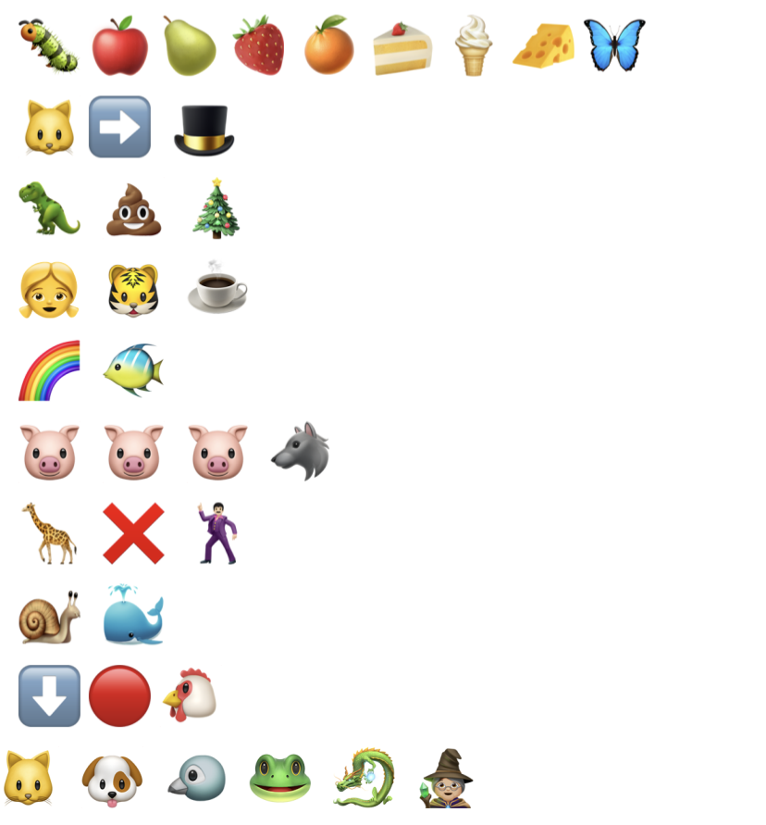
Round 3… Emoji Round – Book Theme
Can you guess the names of the books from the following emojis?
1.
2.
3.
4.
5.
6.
7.
8.
9.
10.

Slide 5










Round 4… Music Round
Can you guess the film that each song is from?
Click each number to listen to the song.

Slide 6

Answers – No peeking!
Round 1:
1. McDonalds
2. Lego
3. Dominos
4. Disney
5. Pringles
6. Play-Doh
7. Apple
8. Tesco
9. Smyths Toy Superstore
10. Google
Round 2:
1. The Grinch
2. The Little Mermaid
3. Rice
4. Yolk
5. His nose grows longer
6. Hogwarts
7. Green
8. 31
9. N
10. Bricks
Round 3:
1. The Hungry Caterpillar
2. The Cat in the Hat
3. The Dinosaur That Pooped Christmas
4. The Tiger Who Came To Tea
5. The Rainbow Fish
6. The Three Little Pigs
7. Giraffes Can’t Dance
8. The Snail and the Whale
9. Little Red Hen
10. Room on the Broom
Round 4:
1. Trolls
2. The Jungle Book
3. Mary Poppins
4. Toy Story
5. Moana
6. Coco
7. Brave
8. Zootopia/Zootropolis
9. Aladdin
10. Tarzan
How did you do? Let us know on Class Dojo!

